Slide 1
Service Enablement of VistA

Slide 2

171
VA Medical Centers
1113
Outpatient Sites
180,000
Medical Professionals
9,000,000
Veterans
Notes:
Every year, over 1300 hospitals and clinics staffed by 180,000 medical professionals, care for 9 million veterans.

Slide 3

Notes:
From 1978 until 2018, the one platform to care for our veterans was VistA.
VistA was built by the VA for the VA. VistA is NOT antiquated legacy software. It has 40 years of continuous development and enhancement tailoring it to the specific needs of Veterans.

Slide 4
Electronic
Health
Record
Notes:
VistA is often called the VA's Electronic Health Record system.
This is wrong. VistA is much bigger than that.

Slide 5

Financial
Scheduling
Lab
7
8
9
÷
2022
4
5
6
×
1
2
3
+
0
.
=
-
Logistics &
Resources
Electronic
Health
Record
O⁻
Notes:
VistA is used in dozens of ways in the VA for Finances, Lab, Resources, Scheduling, Logistics, and yes – also to store Electronic Health Records.
VistA's Electronic Health Record capabilities were purpose built for the unique needs of our Veterans.

Slide 6

Financial
Scheduling
Lab
7
8
9
÷
2022
4
5
6
×
1
2
3
+
0
.
=
-
Logistics &
Resources
Electronic
Health
Record
O⁻
Notes:
The $16 billion Cerner EHR modernization project only duplicates a small portion of VistA's total functionality.

Slide 7
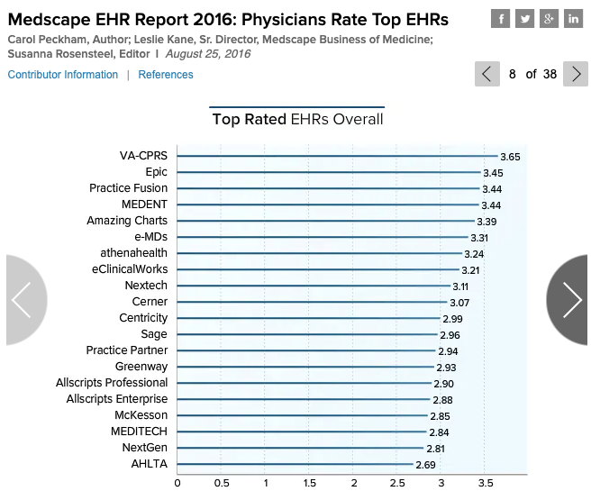

#1
#10
Source: https://www.medscape.com/features/slideshow/public/ehr2016#page=8
Notes:
Specifically, Cerner replaces the top-rated Electronic Health Record system with the one in 10th place according to Medscape's survey of 15,000 physicians.

Slide 8

Physicians | #1 | #10
Other Users | #1 | #5
Ease of Use | #3 | #12
Satisfaction | #3 | #12
Vendor Support | #4 | #9
Connectivity | #1 | #3
Usefulness as a Clinical Tool | #1 | #9
Source: https://www.medscape.com/features/slideshow/public/ehr2016
Notes:
In fact, in Medscape's survey, VistA beat Cerner in every single category.

Slide 9
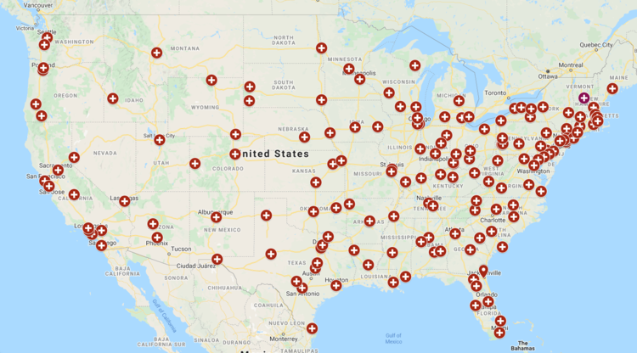
Source: https://www.battlebuddypodcast.net/medical-resources
Notes:
In the last four years Cerner has only been deployed to five out of 131 Vista sites and is already over budget by 6 billion dollars.
---------------------
Sites: Spokane, Walla Walla, Columbus, Roseburg, and White City.

Slide 10
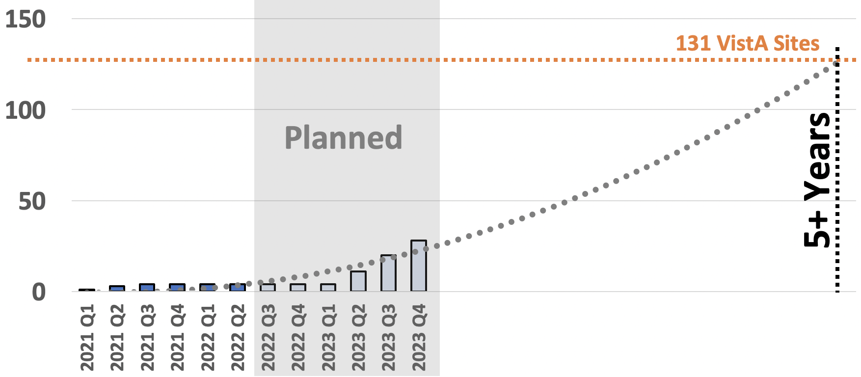
Cumulative Completed Cerner Migrations
Source: https://www.ehrm.va.gov/deployment-schedule
Notes:
Even with assuming no more schedule slips and a very generous trendline based on planned migrations, it will take at least 5 more years to complete the migrations. Some estimates suggest 10.

Slide 11

"
More than a year after a disastrous deployment at its first hospital, the $16 billion effort to modernize veterans’ medical records
still poses grave safety risks to patients, from medication errors to failures to safeguard patients at high danger of suicide, the Department of Veterans Affairs’ internal watchdog has reported.
"
-WaPo March 17, 2022
Source: https://www.washingtonpost.com/elections/2022/03/17/veterans-health-records-failure/
Notes:
The rollout has not gone well.
VA Reports from March described Cerner posing "grave safety risks to patients" especially the most vulnerable – those at risk of suicide.

Slide 12
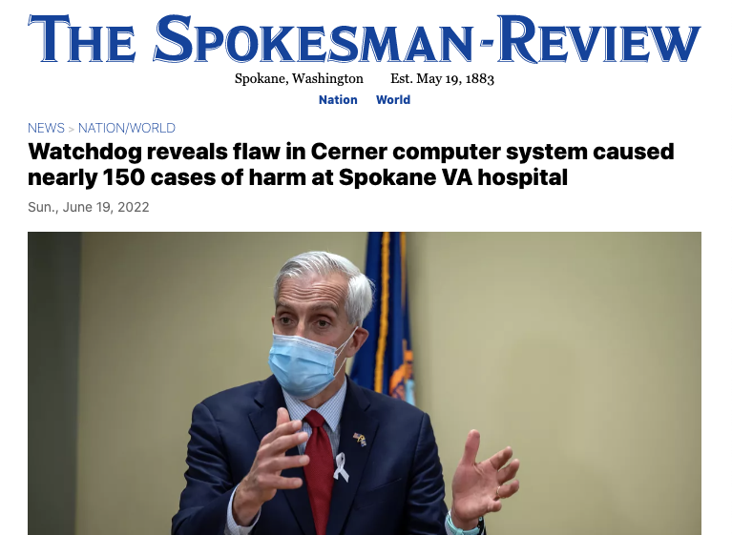
Source: https://www.spokesman.com/stories/2022/jun/19/watchdog-reveals-flaw-in-cerner-computer-system-ca/
Notes:
In June, a local newspaper at the first site where Cerner was deployed received a report detailing nearly 150 cases of harm caused by Cerner.

Slide 13
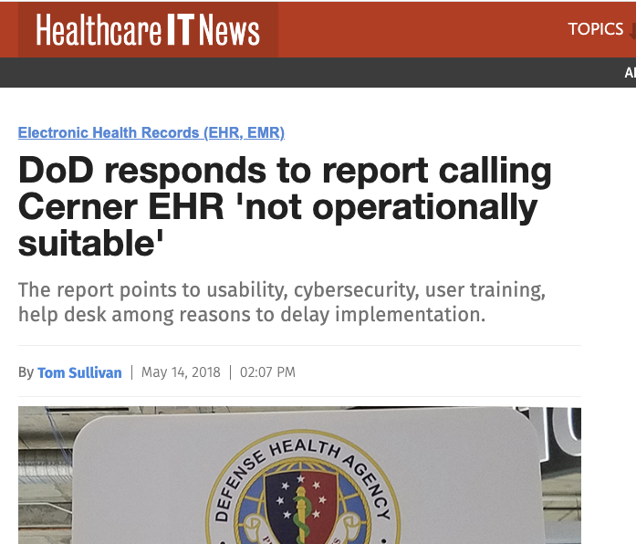
Source: https://www.healthcareitnews.com/news/dod-responds-report-calling-cerner-ehr-not-operationally-suitable
Notes:
This isn't new... or unexpected.
Reports of Cerner being "not operationally suitable" according to the Department of Defense go back to 2018.

Slide 14

VDIF
Veterans Data
Integration and Federation
Notes:
Right now, clinical data is being forwarded to Cerner from VistA via the Veterans Data Integration and Federation platform.

Slide 15
131
Sites
VDIF
Notes:
VDIF does not extract data from VistA.
VDIF aggregates and normalizes clinical data from 131 instances of VistA around the country into a comprehensive longitudinal Veteran Health Record.

Slide 16

131
Sites
VDIF
Notes:
VDIF provides that data in a variety of industry standard formats.
Including HL7 FHIR -- the defacto standard for exchanging health information.
VDIF does all the heavy lifting. Cerner just has to receive the data.

Slide 17
131
Sites
AMPL
CCRA
VDIF
50+
Programs!
BMS
Notes:
VDIF provides true "service enablement” of current, mission-critical, VistA functionality.
At this point, over 50 different VA programs are enabled by VDIF. It has proven success and we’ve just scratched the surface.

Slide 18

Notes:
For these proven successes, VDIF recently won the 2022 FedHealthIT Innovation Award.

Slide 19
131
Sites
AMPL
CCRA
VDIF
50+
Programs!
BMS
Patient Updates
Notes:
Here’s one big problem with the current situation.
All updates made within Cerner Millennium are only accessible via Cerner Millennium.
At the same time, Cerner does not offer the service enablement that VDIF provides. ”Our Veterans' data is being held hostage”

Slide 20
Courses of Action
Share Cerner Data
Replace Cerner
Invest in VistA
Options
All options are enabled by VDIF
Notes:
With every site that converts to Cerner, the VA loses functionality. “We need to stop the bleeding”.
If the decision was made to discontinue the expansion of Cerner, VDIF has the VA covered.
All of these options are enabled by VDIF. We'll talk about them one at a time.

Slide 21
x
131
Sites
Option 1: Share Cerner Data
x
AMPL
CCRA
VDIF
BMS
50+
Programs!
x
Notes:
Option 1. Continue with Cerner… but make Cerner's data feeds bidirectional so that the Service Enablement VDIF provides can be leveraged across the entire VA enterprise.

Slide 22
131
Sites
Option 2: Replace Cerner
AMPL
CCRA
VDIF
ANY EHR
50+
Programs!
BMS
Notes:
Option 2: Replace Cerner with a better commercial EHR. VDIF provides the VA an escape route because it can feed any commercial EHR.

Slide 23
131
Sites
Option 3: Reinvest in VistA
AMPL
CCRA
VDIF
50+N
Programs!
BMS
Notes:
Option 3. Choose to reinvest in VistA and start extracting the data from Cerner using VDIF. VistA is the top rated EHR in the world. Make it EVEN BETTER.

Slide 24
131
Sites
Reclaim
Veteran
Records
AMPL
CCRA
VDIF
50+N
Programs!
BMS
Notes:
If the decision is made to turn off Cerner today, the patient data can begin being extracted by VDIF tomorrow.
In all of these options, VDIF enables the way forward. It is already successfully deployed and operating today in the VA, enabling health interoperability between Vista, the new EHR, and community care providers. It’s received rewards for what it currently provides - let’s not leave untapped potential on the table.

